Slide 1
PREDICTING ONLINE SHOPPER PURCHASE INTENTION
Submitted to Prof. Eitel J. Lauria.
Manish Varkala(20151005)
Sumaj Reddy Pannala(20147141)
Goutham Kasula(20150992)

Slide 2
TABLE OF CONTENTS
01
04
02
05
03
06
Introduction
Methodology
Objectives
Key Findings
Problem Statements
Conclusion

Slide 3
INTRODUCTION
The project aimed to analyze online shopping data and predict purchase intent based on various features. A dataset comprising 12,330 entries with 18 features, including administrative, informational, and product-related metrics, was used for analysis. The goal was to build a predictive model to understand the factors influencing online purchase decisions and provide insights for marketing strategies.

Slide 4
Objectives
Understand Feature Correlations: Examine relationships among features to identify potential drivers of revenue.
Visitor Behavior Analysis: Explore visitor types, their distribution, and the impact on revenue.
Predictive Modeling: Utilize machine learning models to predict revenue and evaluate their performance.

Slide 5
Problem Statement
The client sought to optimize website performance and revenue generation by understanding the relationships between various features and predicting revenue based on visitor behavior.

Slide 6
Methodology

Slide 7

PROJECT ARCHITECTURE
Data Collection
Preprocessing
EDA
Feature Engineering
Model Building
Evaluation
Key Findings

Slide 8
Data Preprocessing
The dataset revealed 18 features
Data cleaning involved handling missing values, which were found to be absent in the dataset.
Categorical variables were converted into binary values and one-hot encoded to facilitate model training
The dataset was split into training and testing sets using the train_test_split function.

Slide 9
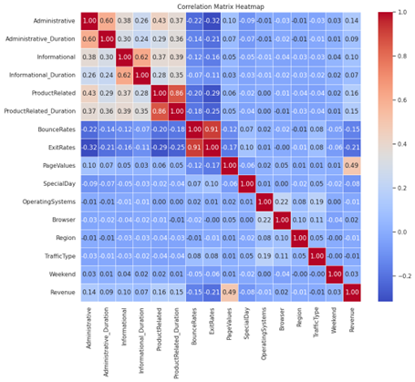
Exploratory Data Analysis
High positive correlation between 'PageValues' and 'Revenue' suggests pages with higher values are likely to generate more revenue.
Negative correlations with 'BounceRates' and 'ExitRates' indicate decreased revenue likelihood with higher bounce and exit rates. Strategic optimization, like focusing on high 'PageValues' pages and minimizing bounce rates, can enhance revenue generation.

Slide 10
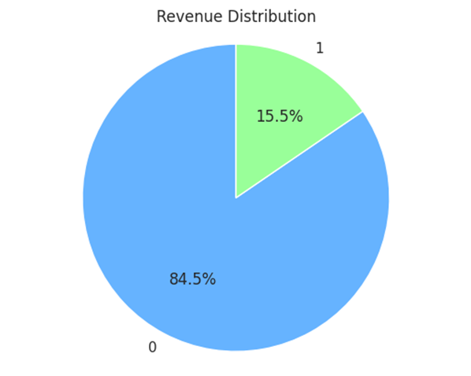
Visitor Analysis
Revenue Distribution:
The chart shows that out of total visitors, only 15.5 percent of purchases were made and other 84.5% just browsed the website and did not converted into revenue.

Slide 11
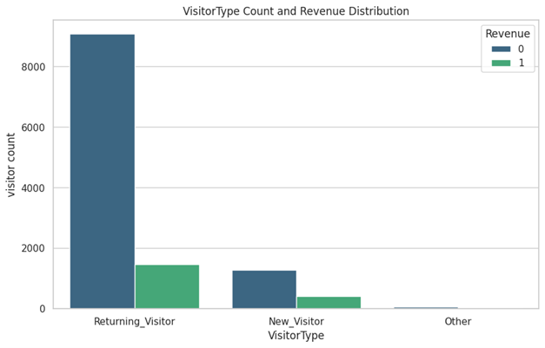
Visitor Analysis
Visitor Type Revenue Distribution:
Returning visitors had 10,000+ visits but only around 1,700 purchases. New visitors, with 1,600 visits, made less than 700 purchases. Minimal visits and purchases noted for other visitor types.

Slide 12
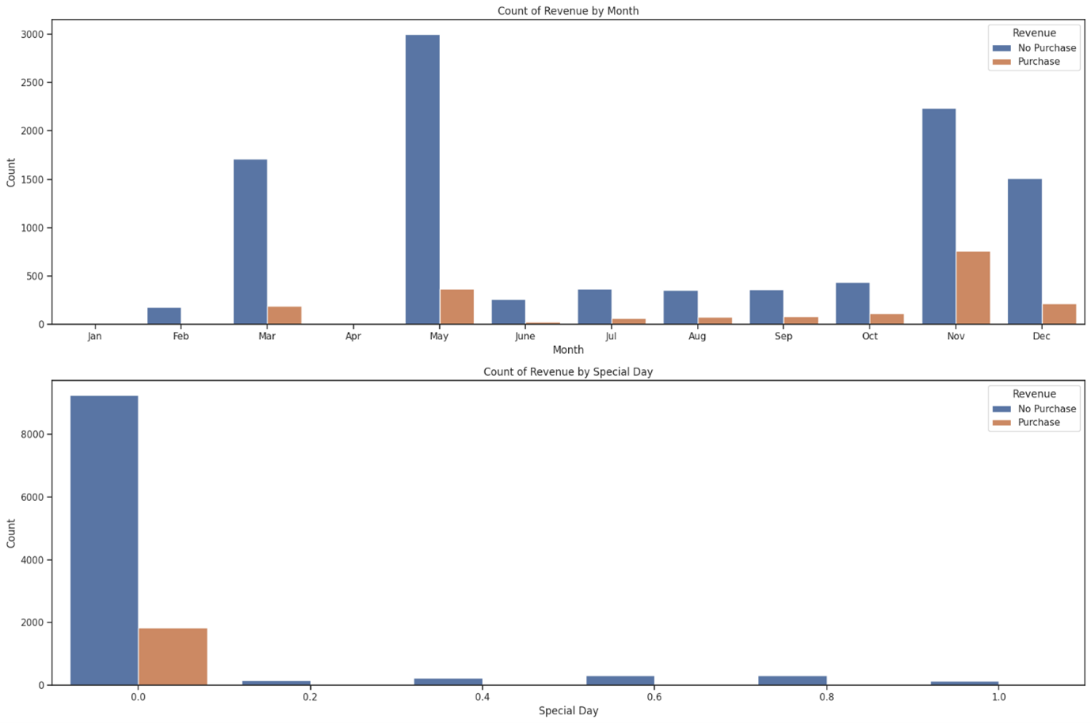
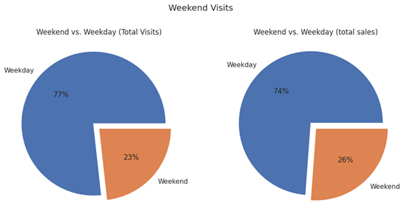
Visitor Analysis
Visitor Type Revenue Distribution:
Charts indicate November as the peak for purchases, with January and February having few to no sales. Special days like Black Friday drive high sales. Weekdays dominate both visits (77%) and transactions (74%), signaling a higher likelihood of purchases during the week.

Slide 13
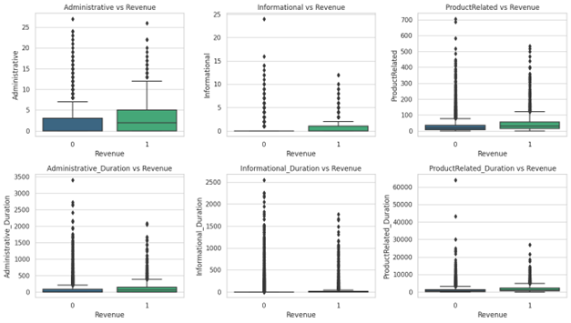
Web Page Analysis
Purchasers have higher page views and longer time, indicating stronger conversion likelihood.
Non-purchasers show lower engagement with lower page views and shorter time on pages.
Visitors invest more time in product pages, emphasizing the need for compelling product content to drive conversions.

Slide 14
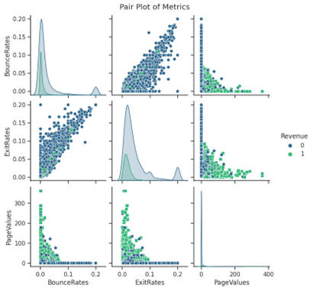
Page Metric Analysis
Visitor Type Revenue Distribution:
Bounce rates and exit rates are positively correlated, suggesting visitors bouncing more also tend to exit.
Page values and exit rates are negatively correlated, indicating longer time on the site reduces page exit rate.
Potential buyers have lower bounce rates and spend more time on the website.

Slide 15
Models
Model | Accuracy | Precision | Recall | F1 Score | ROC AUC
Naive Bayes | 0.86 | 0.55 | 0.58 | 0.56 | 0.75
KNN | 0.85 | 0.56 | 0.58 | 0.56 | 0.65
Logistic Regression | 0.88 | 0.76 | 0.35 | 0.48 | 0.67
Random Forest | 0.90 | 0.73 | 0.56 | 0.63 | 0.76
MLP | 0.88 | 0.75 | 0.35 | 0.47 | 0.75

Slide 16
Model Evaluation
Naive Bayes Achieves 86% accuracy with balanced precision and recall (F1: 0.57), effectively predicting positive instances.
K-Nearest Neighbor (KNN) Shows 85% accuracy, but struggles with low recall (0.27), indicating limitations in identifying actual positive instances.
Logistic Regression Demonstrates 88% accuracy with a balanced trade-off between precision and recall (F1: 0.49), showcasing overall strong predictive ability.
Random Forest Impressive 90% accuracy, balanced precision and recall (F1: 0.64), indicating overall robust performance in classification tasks.
MLP Classifier Achieves 88% accuracy, with high precision (0.76) but lower recall (0.35), suggesting good identification of positive instances but room for improvement in recall.

Slide 17
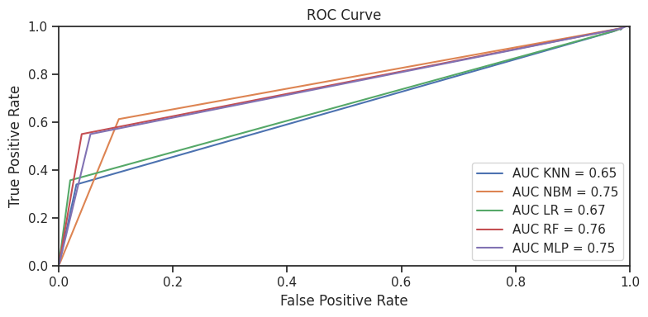
Model Evaluation

Slide 18
Key Findings
Visits by Returning visitor are higher than new visitors, it means more visits were made by returning visitors rather than new visitors.
The majority of revenue was generated by customers who visited the website before rather than new new visitors, underlining the significance of converting visits into transactions.
Feature importance analysis highlighted that 'ProductRelated' and 'PageValues' had strong positive correlations with revenue. This suggests that pages with more product-related content and higher intrinsic values tend to generate more revenue.

Slide 19
Key Findings
Potential buyers have higher page views and spend longer time on the website also has low exit rates, Non-purchasing visitors have lower page views and spend shorter time on website have higher bounce and exit rates.
Visitors spend more time on product related pages rather than account related pages.
Model Performance:
The Random Forest model appears to be the best choice as it has the highest accuracy (0.89) and strong performance across precision, recall, F1 score, and ROC AUC.

Slide 20
RECOMMENDATIONS
Feature Optimization - Focus on optimizing pages with higher 'PageValues' and enhancing content related to 'ProductRelated' and 'Administrative' to positively impact revenue.
Visitor Engagement - Implement strategies to retain repeat visitors, such as targeted promotions or loyalty programs.
Minimize Bounce and Exit Rates - Prioritize reducing bounce and exit rates through improved website design, content, and user experience.
Strategic Content Tailoring - Leverage knowledge of special days to tailor content and promotions for maximum revenue generation.

Slide 21
Conclusion
The predictive analysis provides valuable insights into feature correlations, visitor behavior, and predictive modeling for revenue generation. By implementing the recommended strategies, the client can optimize website performance, enhance user engagement, and ultimately increase revenue. Continuous monitoring and refinement of these strategies will be crucial for sustained success

